Slide 1
Hotel Reservation

Slide 2
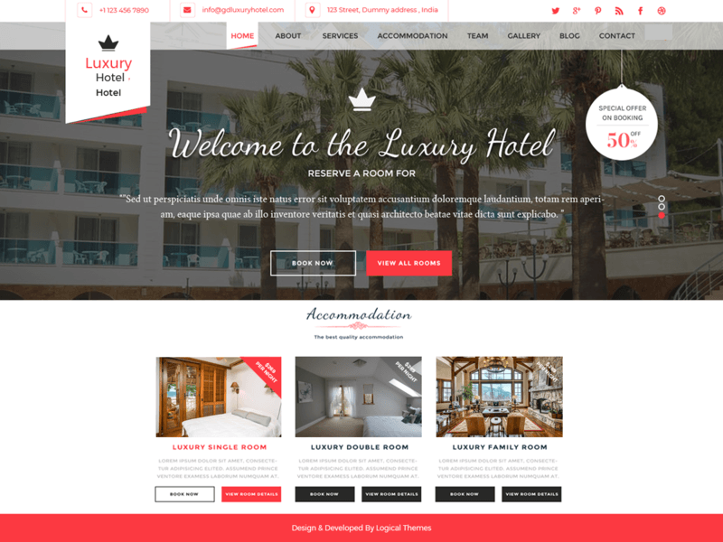
For signed user
logout
setting
logout
Account
setting
Brief info
About us
Room with offer or discount

Slide 3
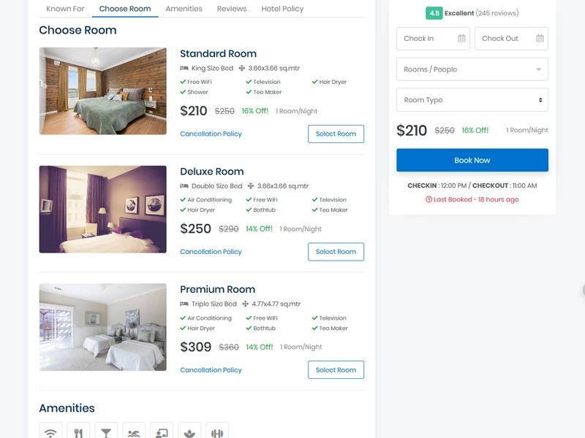
logout
logout
setting
Booking and service
Last day in the room
first day in the room
Select the room
Book now
How many person
Room type

Slide 4
logout
setting
Slider filled with our team public info and ther social media account

Slide 5
logout
setting
Slider filled with our logo phone number
Email
Location on google map
feedback
firstname
lastname
Leave comment here
submit

Slide 6
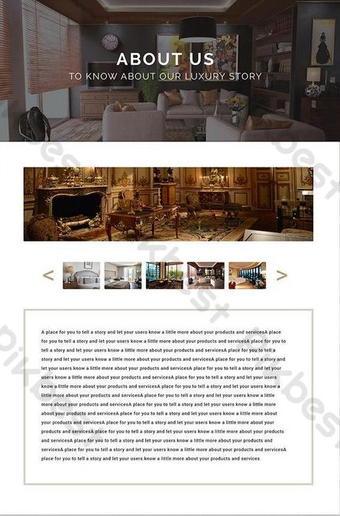
logout
setting
logo
Picture preview
Pic group of our hotel
More info about us

Slide 7
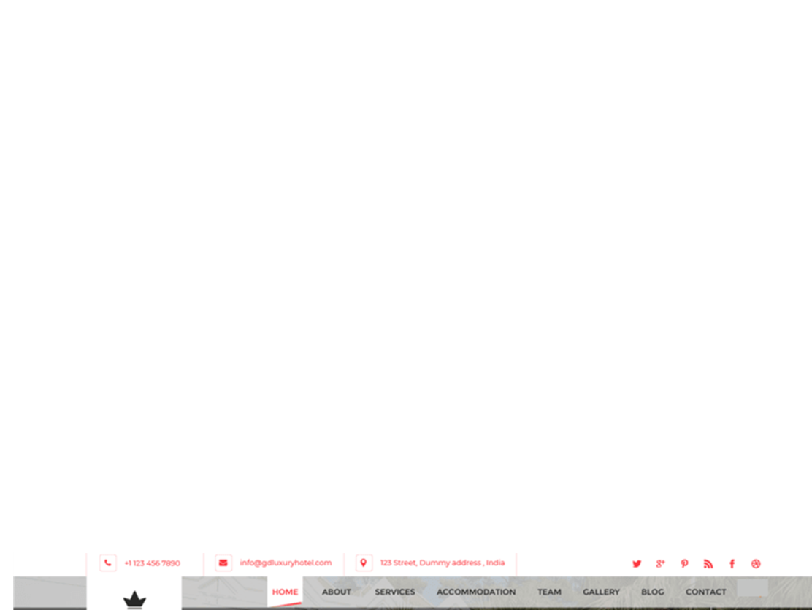
logout
setting
For un signed user from setting choose login/sign up
Log in to your account use email and password

Slide 8
logout
setting
OR
Create one if you don’t have because the user need one when book a room

Slide 9
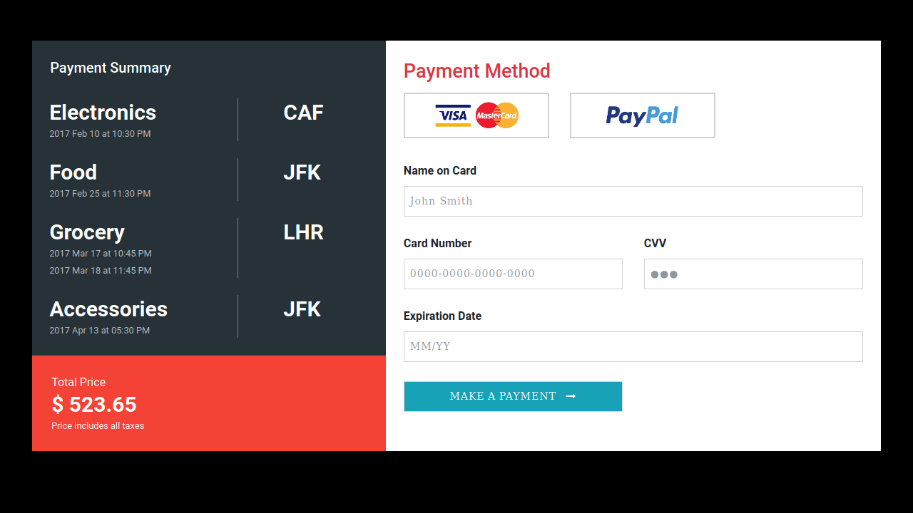
payment
User can choose any payment and fill with the require data
Total amount
Payment info

Slide 10
logout
setting
The page will appear when there are something wrong or missing

Slide 11
logout
Add room
setting
Add Room:
Form to add room into website
number
type
price
specialty
Add Room

Slide 12
Add employee
logout
setting
Form to add employee to website and add some information name , phone , email , and LinkedIn profile.

Slide 13
Admin can search for specific employee
logout
List
setting
Admin can update, delete, or read more about this employee
List all employee
Admin can search for specific room
Room
Admin can see all the rooms that user want to book
List all rooms with some information

Slide 14
Thank you for watching

